Slide 1


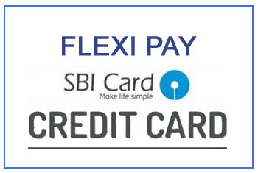

Training Module
SBIC
Flexi Pay
Website- www.sbicard.com

Slide 2
What is Flexipay….?
?
Flexi pay
By SBI Card
Customer Care- STD Code-39020202
Chargeable 1860 180 1290
Toll Free 1800 180 1290
Wondering What is Flexi pay?
Website- www.sbicard.com

Slide 3
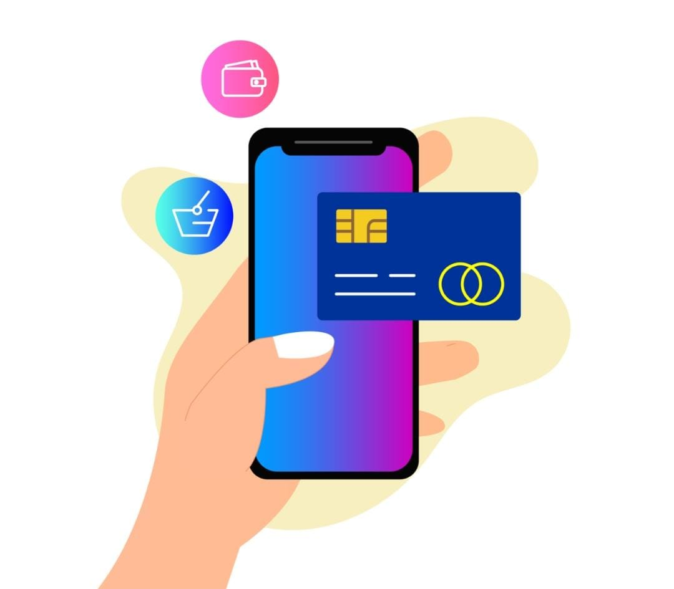
Content…..
About Flexipay by SBI
Definition of Out-Line & In-Line
Feature & Benefits
Types of Interest Rate
Benefits-Reducing & Flat ROI
Fees & Charges
Calling Script & Talk Offs
FAQ’s
Website- www.sbicard.com

Slide 4
Flexi-pay by SBI card
Pay back your big purchases in flexible installments !
“Training Pitch”
With SBI Card, you can convert your transactions into easy installment.
Make big purchases and enjoy paying back with our flexible pay back options
Website- www.sbicard.com

Slide 5

Out-Line & In-Line…….
What is Flexi-pay?
With SBI Card, you can convert your transactions into easy installments. Make big purchases and enjoy paying back with our flexible pay back options.
Multiple options
Website- www.sbicard.com

Slide 6

FAB Technique - Features and Benefits
Pre-approved
No documentation required & No Paperwork ( Hassle Free Process ) ☺
Convert your transactions into Flexi EMI within 30 days of the purchase
Any transaction of Min. Rs. 2,500 or above can be converted into Flexipay
Flexible repayment Tenure option of 3, 6, 9, 12, 24 & 36 months with attractive ROI
Rate of interest at 20% per annum (It is reducing however need not to tell proactively).
Attractive Rate of interests also being provided to our valuable customers during the offers .( Terms and Condition applicable)
Current Offer- 12% ROI P.A (Tenure- 3,6,9 & 12 months)/ 13% ROI P.A (Tenure- 24 & 36 months)
For the tenure of 36 months the eligible amount should be Rs.30,000/- or more than Rs.30,000/-
Waiver of Processing Fees- Tenure should be 12 months and above & Eligible amount should be Rs.30,000/- or above.
Website- www.sbicard.com

Slide 7


Let’s understand the type of ROI
Flat Rate of interest
Flat interest rate, as the term implies, interest rate is calculated on the full amount of the EMI throughout its tenure without considering that monthly EMIs gradually reduce the principal amount.
Interest amount remains same as Principal remains same.
Reducing Rate of interest
Reducing interest rate, means an interest rate that is calculated every month on the outstanding loan amount. In this method, the EMI includes interest payable for the outstanding loan amount for the month in addition to the principal repayment.
After every EMI payment, the outstanding loan amount gets reduced.
Therefore, the interest for the next month is calculated only on the outstanding loan amount.
Website- www.sbicard.com

Slide 8
Fees & Charges
Interest rate of 20% per annum as communicated in the credit card offer is applicable.
Interest Rate may change based on the offers provided by SBI CARD.
Current Offer- 12% ROI P.A (Tenure- 3,6,9 & 12 months)/ 13% ROI P.A (Tenure- 24 & 36 months)
A one-time processing fee will be charged at the rate of 2% of the principal amount subject to a minimum of Rs.249 & maximum of up to Rs.1500 + GST.
In case Customer wish to foreclose their Flexi-pay Plan, after 45 days they can foreclose and a 3% of foreclosure fee will be levied on the remaining outstanding principal amount will be charged Plus GST.
Website- www.sbicard.com

Slide 9
Understanding Amortization Schedule
Illustrative Examples
Amount | 21000
Rate Of Interest | 12.00%
Tenure | 9
Simple Interest | 1,063.93
EMI'S | 2451.55
IRR/Month | 0.01
IRR/Year | 12.00%
Asset Revolved | FALSE
Date | 5/12/2022
S.tax | 24
Processing Fee | 420
GST | 75.6
Total | 495.60
Reducing Rate Calculator
MRA Billing Date | EMI | Simple Interest | Prinicpal | Principal Outstanding | GST | EMI & GST
 | Rs. (21,000) |  | n | 21000
5/12/2022 | 2,451.55 | 210 | 2,241.55 | 18,758.45 | 37.8 | 2,489.35
6/12/2022 | 2,451.55 | 187.58 | 2,263.97 | 16,494.48 | 33.76 | 2,485.32
7/12/2022 | 2,451.55 | 164.94 | 2,286.61 | 14,207.88 | 29.69 | 2,481.24
8/12/2022 | 2,451.55 | 142.078 | 2,309.47 | 11,898.41 | 25.57 | 2,477.12
9/12/2022 | 2,451.55 | 118.98 | 2,332.57 | 9,565.84 | 21.41 | 2,472.97
10/12/2022 | 2,451.55 | 95.65 | 2,355.89 | 7,209.95 | 17.21 | 2,468.77
11/12/2022 | 2,451.55 | 72.09 | 2,379.45 | 4,830.50 | 12.97 | 2,464.53
12/12/2022 | 2,451.55 | 48.30 | 2,403.24 | 2,427.26 | 8.69 | 2,460.24
1/12/2023 | 2,451.55 | 24.27 | 2,427.28 | -0.02 | 4.36 | 2,455.92
Website- www.sbicard.com

Slide 10

Flexipay FAQ’s
1. What is flexipay ?
Flexipay is a facility offered to existing SBI credit cardholders to convert their big purchases into easy monthly installments. Any SBI Cardholder, with a transaction greater than Rs. 2,500 can convert the said transaction into Flexipay within 30 days. Please note, delinquent or blocked cardholders would not be able to avail this service.
2. How to book Flexipay ?
You can convert your transaction into Flexipay instantly in 3 simple ways, as per your convenience
Website
Log in to your SBI Card online account
Click on ‘Flexipay under the Benefits section ’ on the left hand navigation
Select the transaction(s) >= Rs. 2,500 you want to convert into Flexipay, select the tenure and rate of interest and confirm the booking
Mobile App
Log in with the website log in Username & Password
Click on ‘Benefits’ option in the main menu and select Flexipay
Enter the required details and confirm to book Flexipay in 3 simple steps
Helpline
Call up our SBI Card helpline at 1860 180 1290 / 39 02 02 02 (with local STD code)
Website- www.sbicard.com

Slide 11

Flexipay FAQ’s
3. Can I convert all my card transactions into Flexipay?
Convert the transactions with the below conditions
Retail purchase which is done by using your SBI Credit Card
Transactions which were done within last 30 days Transactions, whose value is >=Rs.2,500.
Multiple retail transactions, whose value is >=Rs.2,500 can be converted into a single Flexipay plan
Transactions settled by the merchant, from whom you have made a purchase, using your SBI Card
Conditions which can not convert the transactions into Flexipay
Interest, fees or any other charges levied on your card
Website- www.sbicard.com

Slide 12

Flexipay FAQ’s
4. Can I convert all my card transactions into Flexipay?
The minimum booking amount for Flexipay is ₹ 2,500. This may vary in case of specific offers.
5. What is the interest rate applicable for Flexipay?
The interest rate applicable on Flexipay might vary from based on different offers provided by SBI card. You can visit our website or call SBI Card helpline to know about the Flexi-pay rates.
6. What is the processing fee applicable to convert the transactions into Flexi-pay?
You need to pay a one time processing fee of 2% on the principle amount which is being converted into Flexipay,
Subject to a minimum of ₹ 249 and a maximum of ₹ 1,500 + Applicable Taxes.
Website- www.sbicard.com

Slide 13

Flexipay FAQ’s
7. What are the different tenures available to book Flexipay?
Flexipay can be booked for a period of 3, 6, 9, 12 or 24 months. 36 months tenure is also available, however it can only be availed for booking amount greater than or equal to ₹ 30,000.
8. How do I know how much Flexipay amount I can book?
Flexipay can be booked for a minimum amount of ₹ 2,500 and above. The maximum amount would be determined by your retail balance and the available credit limit at the time of booking.
Please call on SBI Card helpline for more information.
9. I am an add-on cardholder, Can I book Flexipay on my card?
No, Flexipay can be only booked on a primary card by the primary card holder of the particular card.
10. How and when would the Flexi-pay installment be billed?
Flexipay installments would be billed as a part of the monthly card statement. The first installment would reflect in the first card statement generated after you have booked Flexipay.
Website- www.sbicard.com

Slide 14


Flexipay FAQ’s- Cancellation/Foreclosure
11. Can I cancel/pre-close my flexipay request ?
You can place a request for cancellation by calling on SBI Card helpline. If the cancellation request is placed within 45 days of booking, no charges would be levied on the customer’s SBI credit card.
In the event of cancellation request is being placed post 45 days of booking, a foreclosure fees of 3% on the remaining principal amount plus applicable taxes would be levied from customer’s SBI credit card and customer needs to pay the remaining outstanding amount in one shot payment.
Website- www.sbicard.com

Slide 15
SBIC Flexipay Script-Call Flow
Flexipay Script-Updated 2.6
Opening & RPC | Good Morning/Afternoon/Evening Sir/Ma’am, my name is ____ & I am calling from premium servicing team, on behalf of SBI Card, kya meri baat Mr./Ms. ____ se ho rahi hai?
If Yes | Kya ye sahi samay hoga apse baat karne ke liye
If No | Apse baat karne ke liye sahi samay kya hoga takie main apko apke credit card pe jo offer diya jara ha hai uski jankari de saku
Purpose of Call | Aap hamare valuable customer hai isliye ab hum apkko offer de rahe hai- agar apka eligible amount 30,000 ya use zayada hai or aap 12 month ka tenure choose karte hain to apki processing fee Maaf ker di jaegi, sath hi apka rate of interest bhi 1% Mahine ka charge hoga.
If interested (Security Check) | Sir/Ma’am, verification purpose ke liye , Apke Regd. address ka Area Pincode aur Year of Birth Jaan Sakta hu taki mein aapko aapke card per diye ja rahe offer ki jaankari de sakoon.
Confirm Mode of Payment | Kya main jaan sakta hu ke aap apne credit card ki payment khud se karte hai ya auto debit hota hai (Agar Auto Debit hota hai toh CBR batana hai according to CBR Conditions).
Product Presentation | Mr/Ms___ aapki transaction details ke anusar aap eligible hue hain ___amount ko EMI main convert karwane ke lye. Kya main jaan sakta hu ke ap kitne amount ko EMI main convert karvana chahenge 12 mahine ke tenure ke liye?
 | Jaise ki aapne ___months ka tenure select kiya hai jiski EMI ____hoti hai + Applicable Taxes, Applicable Taxes aapke EMI ke interest part par charge hoti hai, jo har mahine reduce hoti rehti hai. Isi ke sath sath apko 1 time processing fee charge hoti hai, jo ki transaction amount ka 2% hoti hai - min.249 & max.1500 + GST. Apki processing fee hoti hai___including Applicable Taxes
 | Lekin Apko Btana Chahenga jaisa ki apka Amount ______ hai toh Aapki processing fee maaf ker di jaegi
 | Aapko batana chahunga ki future mein aap iss EMI ko foreclose karvana chahte hain to aap isko 45 days ke baad foreclose karva sakte hain, jisme apko 3% foreclosure fee jo ki principal outstanding amount par charge hoti hai + Applicable Taxes.
Tenure | ROI-P.A | ROI-P.M | Save %
3,6,9 & 12 Months | 12% | 1% | 2.35%
24 & 36 Months | 13% | 1.08% | 2.27%
Website- www.sbicard.com

Slide 16
SBIC Flexipay Script- Talk Offs
Kuch zaruri information dena chahunga, kripya dhyaan se suneh-
Talk Offs | English | Hindi
 | This is to let you know that there is an exclusive offer on your card where you can convert transactions above Rs.500 done in last 30 days into easy monthly installments (with minimum booking amount Rs. 2500) at a ____% rate of interest annually. Currently on your card, you are paying monthly interest of 3.35% p.m. approximately, but if you opt for easy installments, you will save interest of _____p.m. approximately. You can repay the amount in installments of 3,6, 9, 12, 24, 36 months at a onetime Processing fee of 2% with a minimum of Rs249 and maximum of Rs.1500 plus Applicable Taxes. IN CASE OF PROCESSING FEE WAIVER – However as informed to you earlier the processing fee has been waived-off for you | Apko bataya ja raha hai ki aapke Credit Card par exclusive offer hai jahan aap Rs. 500 ya usse zyada ke amount ko 30 dino k andar EMI main convert kara sakte hain, jiska minimum booking amount Rs. 2500 ya usse zyada hona Chahiye jisko aap ____% rate of interest annually mein pay kar sakte hain. Agar aap purey amount ko pay nahi kar paatey hain to 3.35% monthly interest lagta hai, EMI main convert karvane se aap ______( approximately) har mahine save kar skte hain. Is amount ko aap vapas kar sakte hain 3/6/9/12/24/36 months main aur isme 1 time processing fee lagegi jo 2% charge hoti hai, min.249 aur max.1500 hoti hai plus applicable taxes. Applicable taxes aapke EMI ke interest part par aur processing fee par charge hota hai. Jaisa ki apko bataya gaya h apko processing fee maaf ker diya ja rha hai. Yeh ek hassle free process hai jisme documentation ki zarurat nahi hoti hai.
 | Applicable Taxes will be charged on the Interest component of EMI & Processing Fee. This is a hassle free process with no requirement of documentation. | Aapki Flexipay EMI ki request book ho gae hai jiska Service Request Number aapko SMS ke dwara agle 24 ghante main prapt hoga.
Website- www.sbicard.com

Slide 17

SBIC Flexipay Script- Closing
Closing & Transfer to Verifier
Consent | Mr./Ms._____ aapki request aage proceed kar sakta hu. Please apna reply YES ya No main dein. Apki Flexipay ki request book kardi gae hai jiska service request number aapko SMS ke dwara agle 24 ghante main prapt hoga aur agle 4-5 business day’s main process kar diya jaega.
Verification Transfer | Please / Kripya line pe bane rahe aapki call ko verification department mein transfer kiya ja raha hai for further verification. Call disconnect na karey, bina verification ke apki Flexipay request ko proceed nahi kiya jaega.
Customer Care Numbers | 1800-180-1290
Toll Free Number | 1860-180- 1290
Chargeable Number | STD Code 39-02-02-02
Website- www.sbicard.com

Slide 18
SBIC Flexipay Script- CBR Conditions
CBR Conditions
CONDITION 1- Agar Statement date aur calling date main 7 din se zyada ka samay hai. (If the Mode of payment is Auto Debit) | Sir, batana chahuga apko approval sms aane par aap customer care pe call karke CBR(Credit Balance Refund) ki request raise karni hogi, jisme aapka jo transaction amount account se debit hua hoga vo ap apne credit card main transfer karva sakte hai ya phir apne personal saving account main bhi transfer karva sakte hai. Auto debit main apka amount pehle deduct hoga aur phir CBR karne ke baad refund hoga.
CONDITION 2- Agar Statement date aur calling date main 7 din se kam ka samay hai toh. (If the Mode of payment is Auto Debit) | Sir, batana chahuga apko approval sms aane par aap customer care pe call karke CBR(Credit Balance Refund) ki request raise karni hogi, jisme aapka jo transaction amount account se debit hua hoga vo ap apne credit card main transfer karva sakte hai ya phir apne personal saving account main bhi transfer karva sakte hai. Auto debit main apka amount pehle deduct hoga aur phir CBR karne ke baad refund hoga.
CONDITION 3 - Agar calling date aur due date main 2 din ka samay hai (aur calling time 4pm se pehle hai) ya 2 din se zayada ka samay hai. (Booking date is 23-Dec-21, advisor can take booking till 4 PM when customer’s due date is 25- Dec-21. For clarity -Not allowed to book when customer’s due date is 24-Dec-21) . (If the Mode of payment is Auto Debit) | Sir, batana chahuga apko approval sms aane par aap customer care pe call karke CBR (Credit Balance Refund) ki request raise karni hogi, jisme aapka jo transaction amount account se debit hua hoga vo ap apne credit card main transfer karva sakte hai ya phir apne personal saving account main bhi transfer karva sakte hai. Auto debit main apka amount pehle deduct hoga aur phir CBR karne ke baad refund hoga.
CONDITION 4- Agar due date aur calling date main 2 din ka samay hai (aur calling time 4pm ke bad hai) ya 2 din se kam ka samay hai: (Booking date is 23-Dec-21, advisor can take booking post 4 PM when customer’s due date is 26- Dec-21. For clarity Not allowed to book when customer’s due date is 25-Dec-21) | Mafi chahege sir, apki flexipay ki request hum nahi le paege, iske liye apko customer care pe call karke apni transaction ko emi main convert karva sakte hai.
CONDITION 5- Agar calling date due date ko cross kar gae hai toh YA transaction expire ho gayi hai | Mafi chahege sir, apki transaction expire ho gae hai// YA // apke statement ki due date cross ho chuki hai, iss amount ko ap EMI main convert nahi karwa paenge.
Website- www.sbicard.com

Slide 19

SBIC Flexipay Script- Guru Mantra
Points to be informed before closing
Agar Customer puchta hai Current Month Due Date Per Kya pay karna hai
Iss Call ke bad apko customer care per call karke batana hoga ki apne is amount / txn ko EMI me convert karwa lia hai.
Sath hi apke current month ki outstanding amount ki jankari bhi apko customer care se mill paegi.
Apke current statement ka Minimum amount due same rahega.
Website- www.sbicard.com

Slide 20

THANK
YOU
-Presented By
Flexipay Training Team
Website- www.sbicard.com

